Slide 1
THE HEALTHCONNECT
How can HealthConnect use Data and AI to reduce missed appointments and improve the patient support experience?

Slide 2
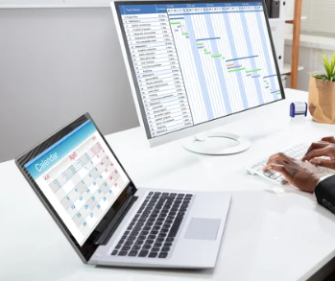
Introduction
HealthConnect Clinic is a fictional healthcare provider seeking to:
• Reduce missed appointments.
• Improve patient appointment attendance.
• Make better use of available appointment slots.
• Provide more effective administrative support to patients.

Slide 3
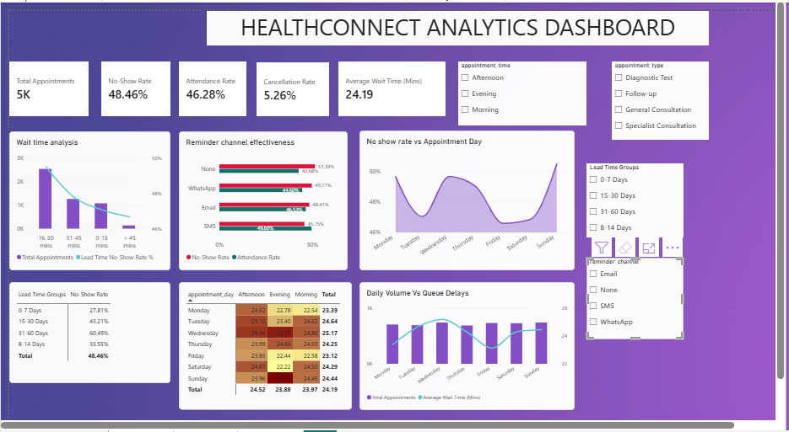
The Executive Dashboard

Slide 4
Validated Findings:
Total Patients: 5000
Overall Attendance rate: 46.28% (2314 patients)
Overall no – show rate: 48.46% (2423 patients)
Overall cancellation: 5.26% (263 patients)

Slide 5
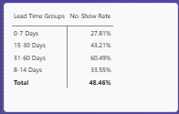
Validated findings (cont…)
Patient attendance rate drops sharply as booking in advance window expands i.e. short lead bookings (0 – 7 days) achieve a 66.56% attendance rate (27.81% no – show rate) while bookings beyond 30 days degrades to 34.10% attendance rate with 60.49% no – show rate.

Slide 6
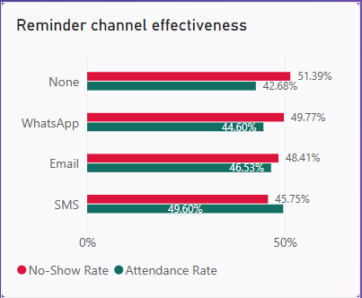
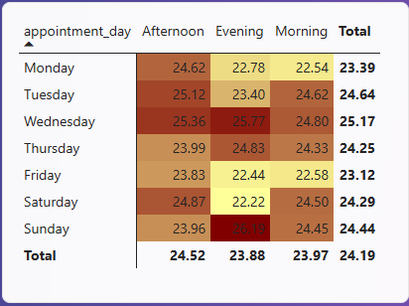
Validated Findings (Cont…)
SMS reminder yielded the highest attendance rate (49.60%) while WhatsApp communication reminder channel reported the highest no show rate (49.77%).
The mean waiting time on average is 24.19 minutes peaking at 26.19 minutes during midweek morning and early afternoon hours (10:00 am – 2:00 pm)
Patients on follow up appointments have the highest no – show rate (51.23%) while the patients on general consultation have the least no – show rate (46.64%)

Slide 7
Business Insights
Long booking lead times (>30 days) contribute to over 48% of no – show appointments. This shows that there is need for overbooking in the first 21 days.
WhatsApp underperforms as a communication reminder channel with 49.8% no show rate indicating a lower patient engagement or non – receipt of automated alerts compared to direct SMS.
The midweek intake queues regularly exceeds the 15 – minute operational target by 11.2 minutes due to unscheduled morning working – in volumes.

Slide 8
Recommendations:
Implement dynamic overbooking by applying +15% overbooking multiplier on time slots containing appointments booking >30 days to offset expected no – shows.
Shift communication channel mix reminder to direct SMS and adding a mandatory 24 – hour pre – appoint SMS confirmation request.
Queue staffing adjustment by shifting the intake staff coverage to peak queue hours (10:00 am – 2:00 pm) to reduce the average wait times towards the 15 – minute benchmark target.

Slide 9
Analytical Limitations
The dataset lacks patient’s external metrics such as income tier, mode of transport and the weather conditions making it difficult for the analyst to fully account for sudden unpredicted attendance drops or queue delays that can be caused by the external factors.
The inability to isolate casual channel behavior whereby while the analysis highlights the channel performance disparity, the data does not capture patient’s preference or delivery receipt status.

